Slide 1
Irregularly Inflected Forms (in the Source)
repaired ⟶ repair -ed ⟶ repair_{1.1} v pst ⟶ X -pst
took ⟶ took ⟶ took_{1.1} v ⟶ Y

Slide 2


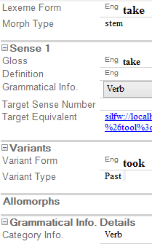
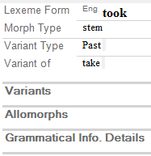
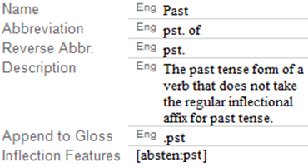
Irregularly Inflected Forms Example
take_{1.1} v
pst

Slide 3
Swedish to German
man ⟶ Mann (singular)
män ⟶ Männer (plural)
dörr ⟶ Tür (singular)
dörrar ⟶ Türen (plural)

